Slide 1
SARA
Monthly Report
Dt: 1st March 2022 – 31st March 2022

Slide 2
Synopsys
Things carried out in the project.
Social media data representation.
Current bottlenecks in the project and possible resolutions
Next course of action.

Slide 3
Utility Chart
- March 1-31 day 2022
Postings on Facebook on a regular basis, as well as keeping all of the content up to date.
March 2022
Up-to-date response management

Slide 4
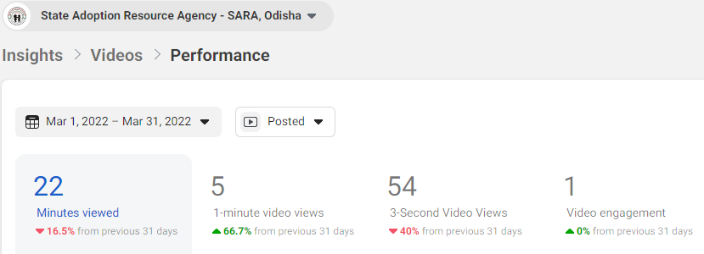

Slide 5
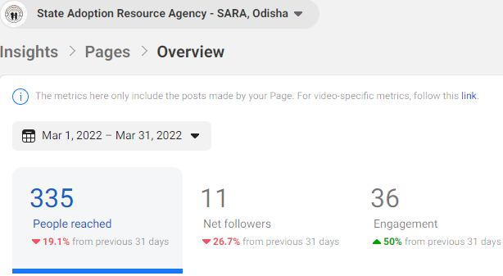

Slide 6
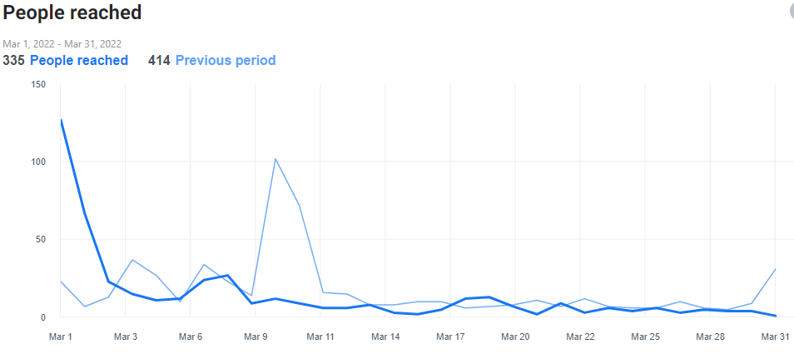
Total Reach

Slide 7
Numbers from Facebook
Reach - 444
Impression - 1080
Page Engagement- 36

Slide 8
Findings
The impressions are being achieved at less numbers.
We are generating the views and impression but recall has not been established yet.
Click to conversion percentage is below average possibly because of lack of authority and trust.
The budget for media spend not established to test multiple campaigns.
All the data achieved organically.
The trend is negative in nature and needs to be optimised by continuous feedback mechanism.
It is more important to start a post engagement and brand awareness campaign.
It is important to launch campaigns on all platforms.

Slide 9
Bottlenecks
Lack of rich images
Low authority of the brand.
No media budget.
Production planning for new content
Real time images

Slide 10
Next course of action
We will gather the targeted audience.
The next step is to launch post engagement & brand awareness campaigns.
Increasing user engagement by posting real-time customer content and feedback..
Creating a window for daily/regular feedback validation with regards to the campaign dashboard.
Allocation of budgets and the launch of the campaigns.

Slide 11
Thank You

